Slide 1
Teaching resources

Slide 2
Activities for Primary students https://www.teachingenglish.org.uk/resources/primary/activities
*

Slide 3
At the beach https://www.teachingenglish.org.uk/article/beach
This collection of short activities
focuses on the topic of the beach.
Visualisation
Packing a suitcase for the beach
Sea animals
Design a fish
Beach songs
The beach is often a popular holiday destination and young children can generally, depending on where you are, relate to the excitement and freedom associated with playing on the beach. To introduce the topic, why not dress a teddy in shorts, t-shirt, sunglasses and cap, and give him a towel to put under his arm? The children can guess where he is going and the lesson will be much more captivating for them than just starting with a picture on the board.

Slide 4
Back writing https://www.teachingenglish.org.uk/article/back-writing
This activity practises vocabulary and spelling and can be good for restless classes.
Procedure
Put students into teams (no more than eight or so in each team) and get each team to line up facing the board.
The student at the front of each line needs chalk or a board pen. Show a word or a picture to all the students who are at the back of each line. Use a word you've studied in class that all the students should know.
The students at the back of the line should 'write' each letter of the word with their finger, on the back of the student in front of them in the line. That student then does the same on the back of the student who's in front of them in the line, and so on. Students should pause between letters, writing the next letter only when they can see that the student in front of them has already passed on the previous one.
The students at the front of the lines write the letters on the board to make the word. The first team with the word written correctly on the board wins.

Slide 5
Calendar Based Activities https://www.teachingenglish.org.uk/article/calendar-based-activities
This lesson is based around the calendar and helping students to use dates.
• Revision of months
• Introducing ordinal numbers
• Understanding dates and finding them on a calendar
• Matching days and dates
• Writing the date
• Follow-up

Slide 6
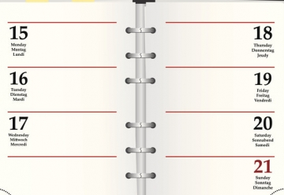
Daily routines https://www.teachingenglish.org.uk/article/daily-routines
This is a simple activity with lots of repetition which is ideal for lower levels.
Procedure
Mime the daily routine sentence by sentence following the list and using the clock to indicate the time. Elicit the full sentence from the students as you do each mime e.g. ‘You wake up at 7.30.'
Mime the whole day in order of time eliciting full forms throughout.
Mime the instructions for students to write down as many sentences as they can remember in pairs. Set a time limit of 5-10 minutes.
Let the students compare answers with your original list and say how many correct sentences they have.
Ask your students to write down their daily routines individually.
Working in pairs one student mimes his/her daily routine to their partner who says the sentences. Encourage the students who mime not to speak. Ask the students to change roles and repeat the exercise.
Ask the students to write down each other's daily routines. Set a time limit of 5-10 minutes.
Ask the students to check with their partners to see how many correct sentences they have. The student with the most correct answers is the winner.

Slide 7
Comparatives and superlatives through pictures
With young learners you can get them to colour their stars and then pin them on the wall according to the size of the stars and then get students to write sentences on a piece of paper about their stars which they will pin on the wall under their picture.
You can then ask them questions such as:
Who has got the biggest star?
Who has got the smallest star?
Is X's star bigger or smaller than Y's star?
A short but fun way to revise comparatives and superlatives is to give students a blank piece of paper and ask them to draw an easy to draw object, such as a star, a tree, a flower or a house on it.
Once students have finished drawing their pictures ask the students either as a class, or in small groups if the class is very large, to line up according to the size of the object that they drew.

Slide 8
Drawing dictations
https://www.teachingenglish.org.uk/article/drawing-dictations
Drawing dictations are a great way to practise vocabulary and to find out how well the students in your class listen to you.
If you've been studying food, dictate instructions for your students to draw a fridge, with the door open, and a range of different food items inside.
Keep the language simple and concise.
For higher levels, have a picture in front of you and describe it to the class. See who, at the end, has the most similar picture to the original. Students can take turns in giving the dictation too.

Slide 9
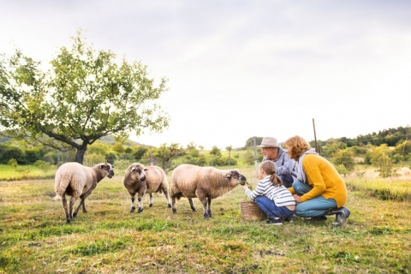
Farm animals https://www.teachingenglish.org.uk/article/farm-animals
Children love units connected with animals and farm animals can provide lots of fun opportunities to practise sounds and phonics.
•Counting sheep (Age: 7+)
•Babe - Video work (Age: 10+)
•Animals and animal sounds (Age: 4+)
•The Farmer’s in his Den – new words (Age: 5+)
•Art work - Farm scene

Slide 10
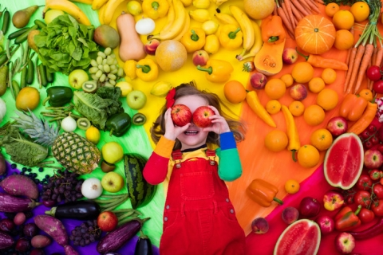
Fruit and vegetables
Food is a popular topic in any primary course and has a lot of potential for cross-curricular work.
Role play
Storybooks
Make your own books
Fruit and vegetable alphabet scavenger hunt
Five a day
https://www.teachingenglish.org.uk/article/fruit-vegetables

Slide 11
Right or Wrong? Right or Left?
https://www.teachingenglish.org.uk/article/right-or-wrong-right-or-left
This is a good activity for checking information for younger learners.
Line up the class in a row facing you.
Say a sentence and students have to decide if the sentence is right or wrong. For example, ‘Today is Friday' or ‘There are 14 students in our class today' or ‘Mateu is wearing a green jumper'.
If the sentence is right students should take a big step to the right. If it's wrong, they should take a big step to the left.
When the students get the idea, one of them can make up the sentences.
If you like, the last person to step, of the students who step the wrong way, can be eliminated.

Slide 12
Vocabulary box
A small box, such as a shoe box, is a very useful tool in the classroom - it can become a vocabulary box. You also need some small blank cards or pieces of paper.
https://www.teachingenglish.org.uk/article/vocabulary-box

Slide 13
Vanishing Dialogue
This activity practises language of ordering food in a restaurant although this can be adapted for any scenario. It's a great way to consolidate the language and recycle the vocabulary.
it also becomes very personalised when students create their own dialogues in the final stage. As the drilling is done in groups it is non threatening and enjoyable.
https://www.teachingenglish.org.uk/article/vanishing-dialogue

